Slide 1

© 2010 Lisa Gansky
Notes:
Access to goods and services …
Both in personal lives and in our businesses

Slide 2

Notes:
Sharing has real history among us humans …
Share platforms invite engagement and participation with many

Slide 3


Slide 4


Slide 5
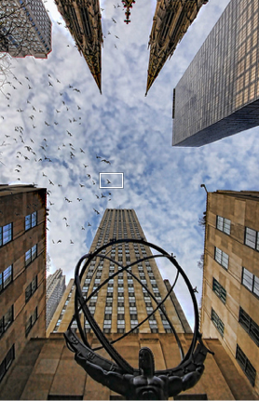

Slide 6



Slide 7

Notes:
What is it?
B2C
B2B (platforms and reclaiming products to enhance brand, ecosystem and value); AWS … the cloud

Slide 8
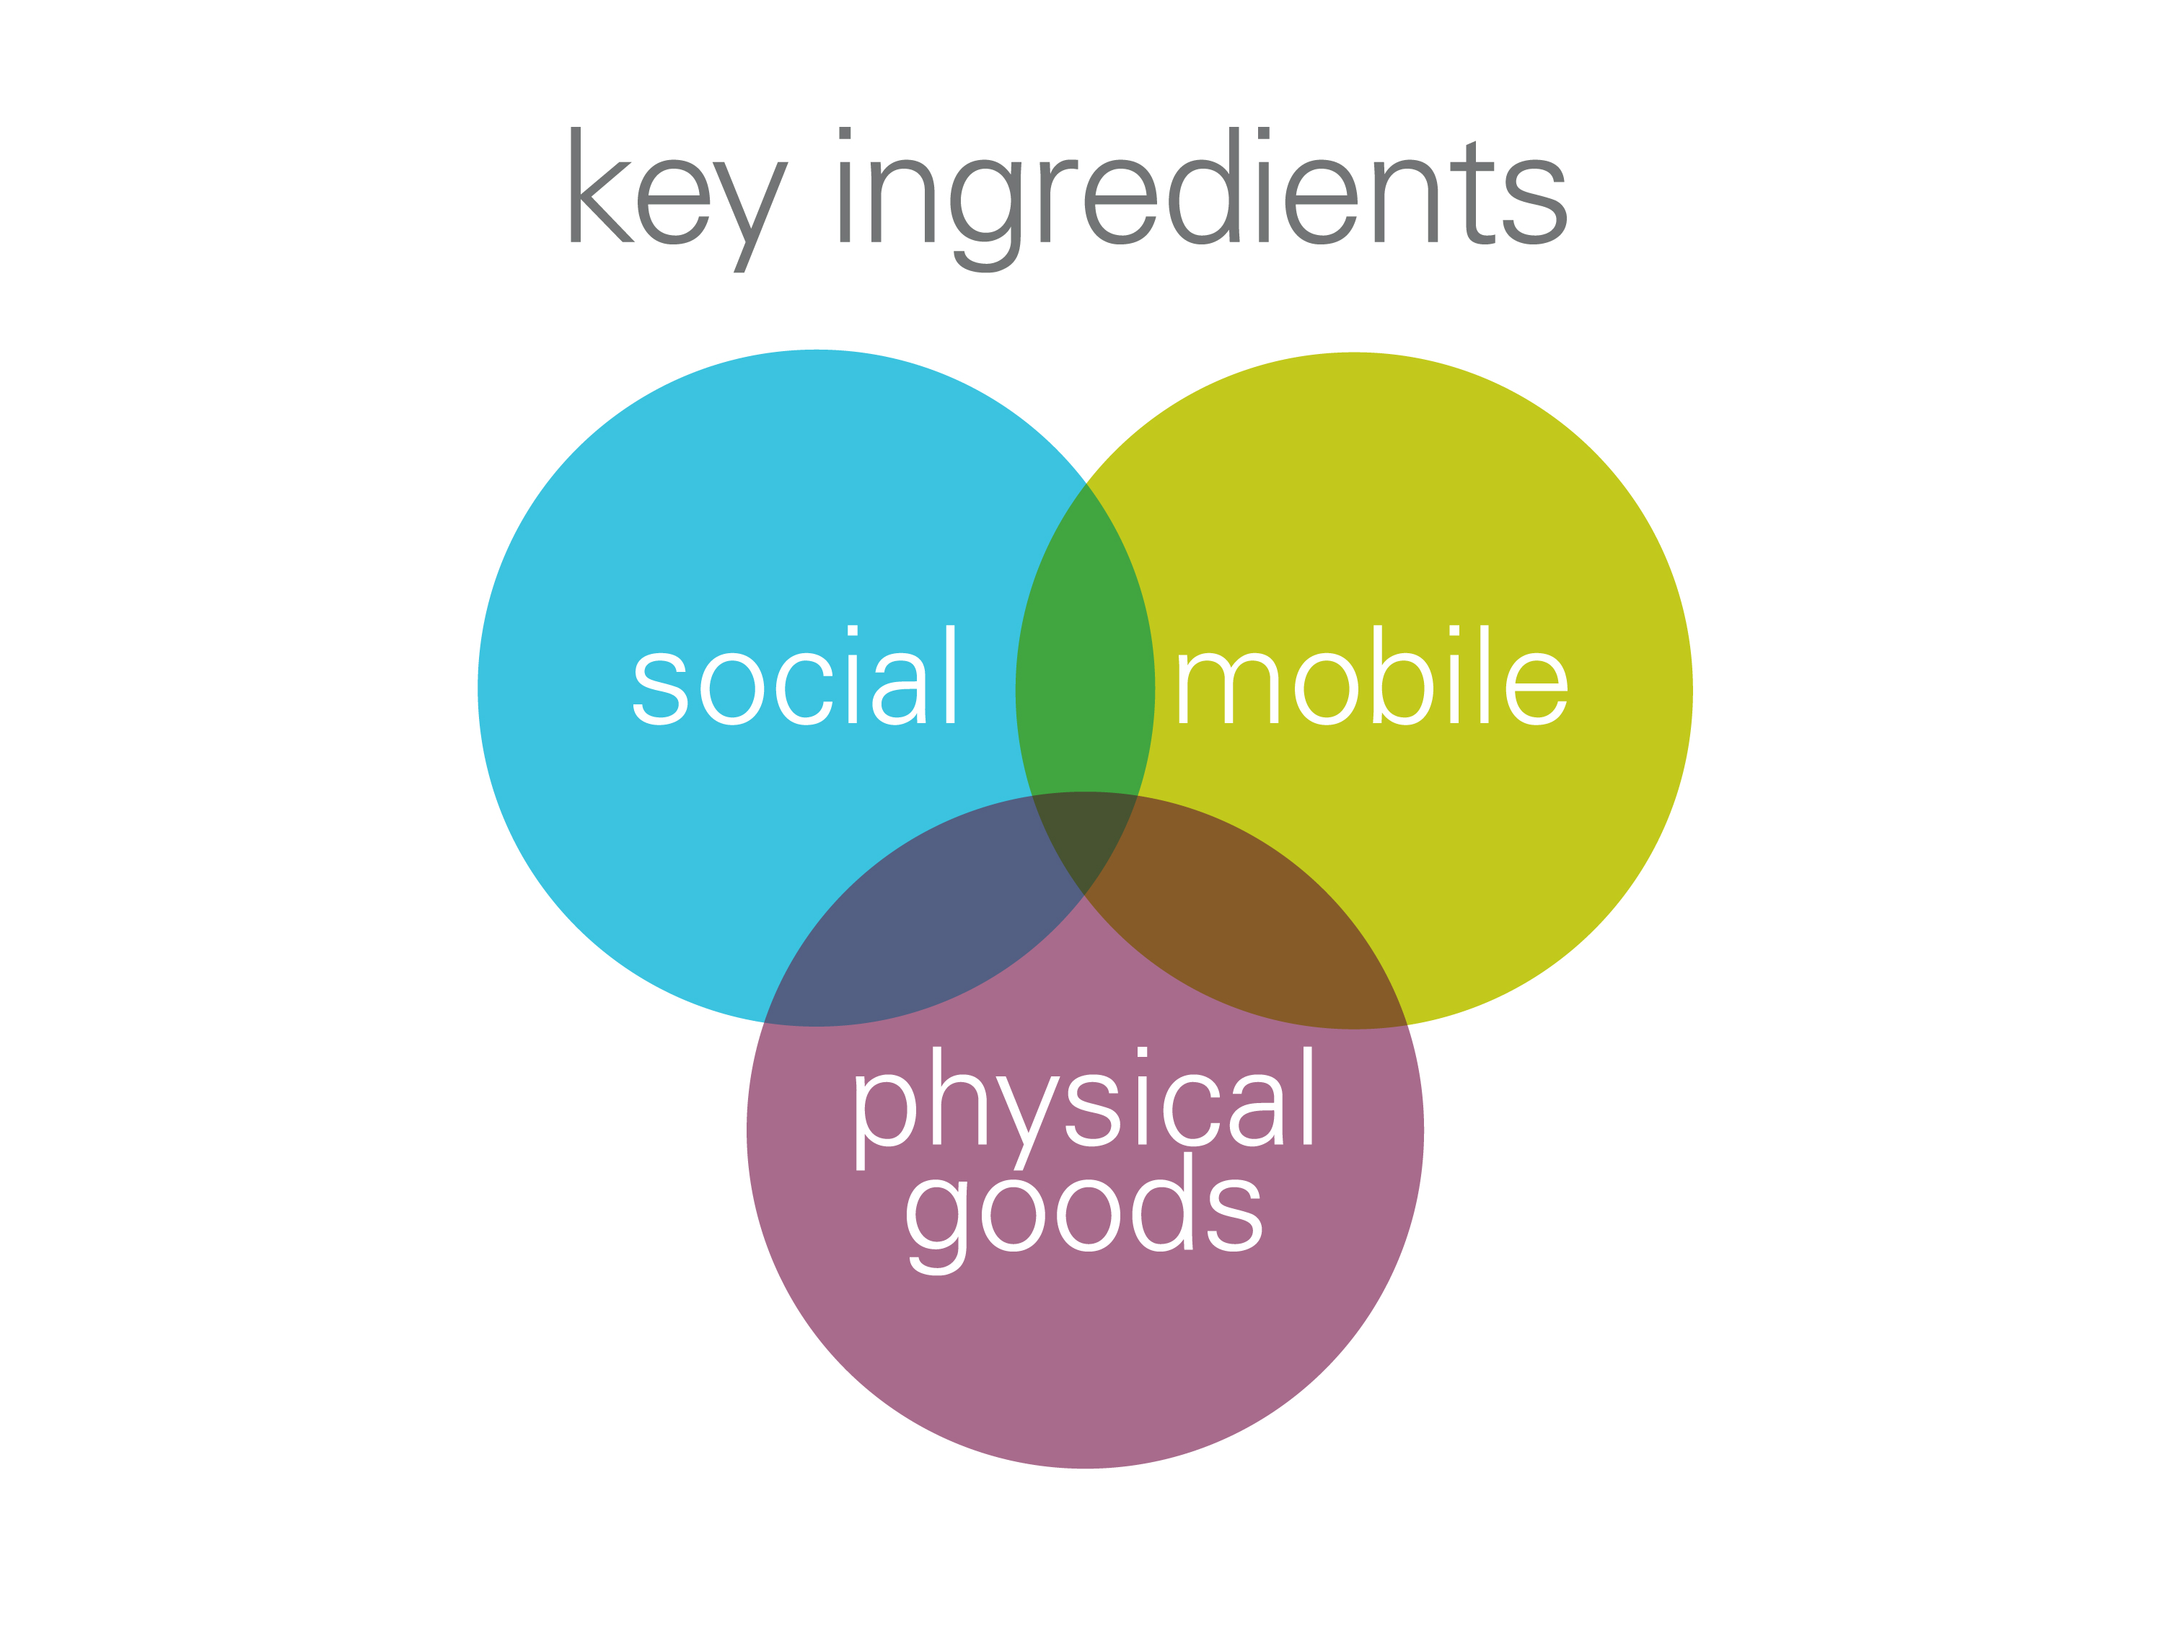

Slide 9


Slide 10


Slide 11


Slide 12


Slide 13


Slide 14


Slide 15
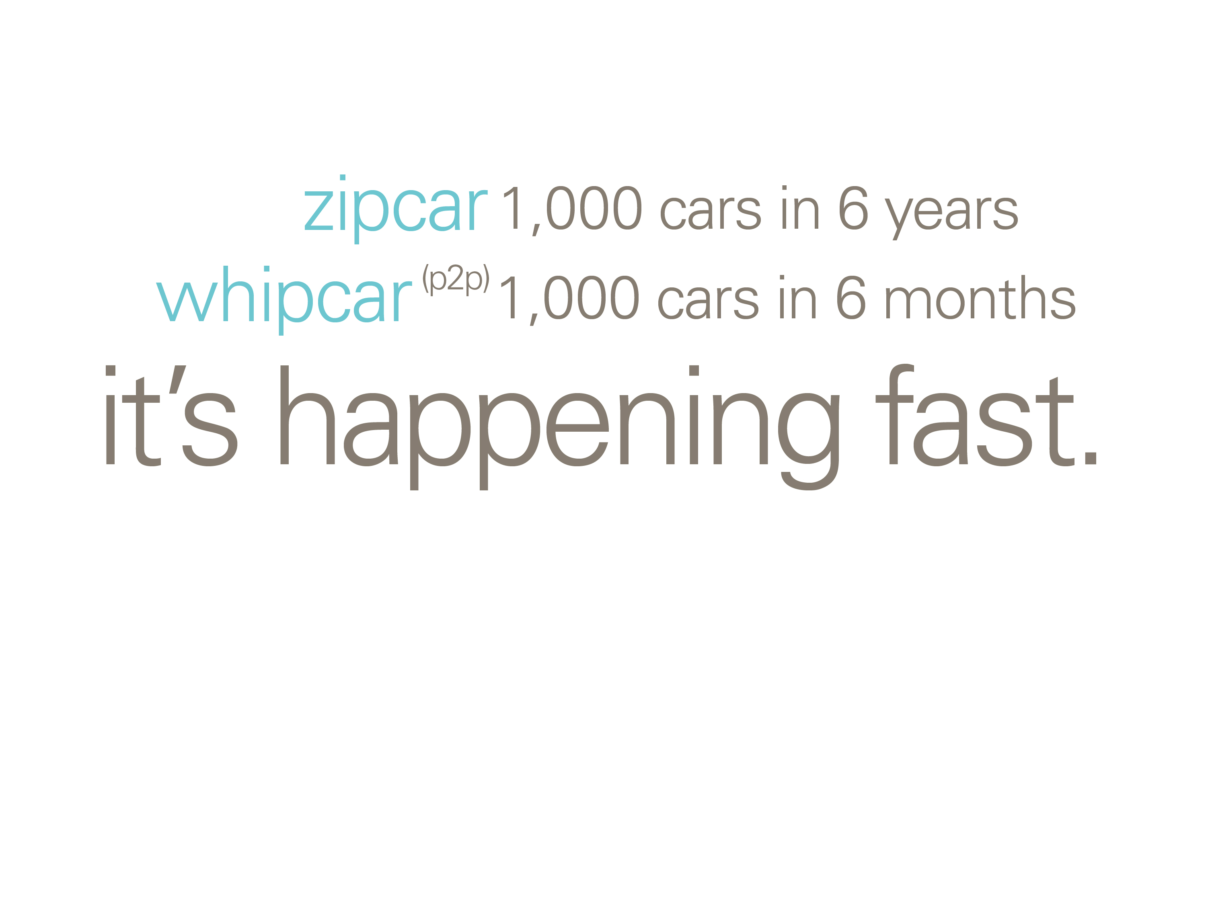

Slide 16
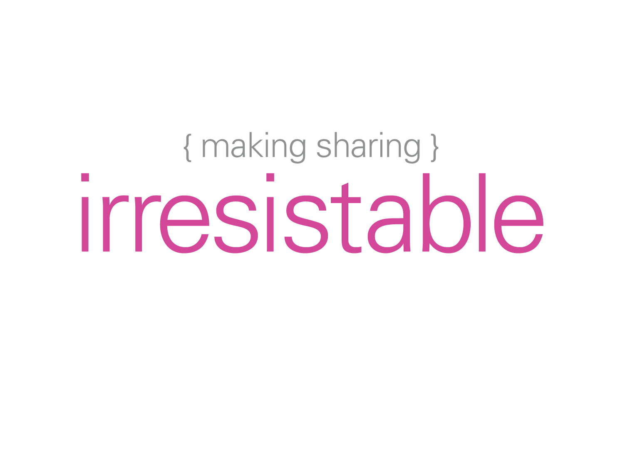

Slide 17
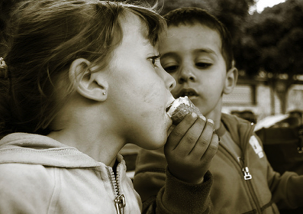

Slide 18


Slide 19


Slide 20
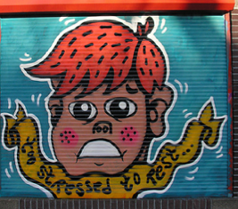

Slide 21


Slide 22


Slide 23


